Slide 1
Deep CNN-supported Ensemble CADx Architecture to Diagnose Malaria by Medical Image
Erteza Tawsif Efaz¹, Fakhrul Alam², Md. Shah Kamal³
¹ Department of Electrical & Electronic Engineering, Ahsanullah University of Science & Technology, Dhaka 1208, Bangladesh; ² Department of Electrical, Electronic & Communication Engineering, Military Institute of Science & Technology, Dhaka 1216, Bangladesh; ³ Department of Electrical & Electronic Engineering, University of Dhaka, Dhaka 1000, Bangladesh

Slide 2
Outlines
Introduction
Related Works
Proposed Methodology
Data collection
Model configuration
Model ensemble
Statistical analysis
Experimental Results
Conclusion

Slide 3
1 Introduction
The summary of this work can be drawn as follows,
Employing a set of standard architecture to measure all parameters.
Assembling several models to improve overall performance.
Differentiating with notable classification methods.
The rest of the sections demonstrated the related works, proposed methodology, and experimental results.

Slide 4
2 Related Works
So, a desirable system needs the traits as below,
Research on patient-level detection by evaluating a large image set.
A compact method for IoT devices through a cloud platform.
Closer accuracy to NIH with less computation.
Microcontroller system gives ample scope for more development in this regard.

Slide 5
3 Proposed Methodology
Fig. 1. Proposed workflow for malaria detection.

Slide 6

3 Proposed Methodology
Fig. 2. A blood smear image subset provided by the NIH [1].

Slide 7
3 Proposed Methodology
Table 1. Distribution of dataset for malaria detection.
Dataset | Parasitized | Uninfected | Total
Training | 10,301 | 10,301 | 20,602
Validation | 1,378 | 1,378 | 2,756
Testing | 2,100 | 2,100 | 4,200
Number of images | 13,779 | 13,779 | 27,558

Slide 8
3 Proposed Methodology
Fig. 3. Architecture of (a) VGG-19 and (b) ResNet-50 adapted from [2].

Slide 9
3 Proposed Methodology
The indices are expressed as stated,
Here, the n^{th} classifier = C_{n}
And, the probability of the n^{th} classifier = P_{n}
For the prediction probability > 0.5, the microscopic blood smear image will be classified as parasitized.
T_{p} = true-positive (determined accurately)
T_{n} = true-negative (determined inaccurately)
F_{p} = false-positive (undetermined accurately)
F_{n} = false-negative (undetermined inaccurately)
The neural network model computation is a crucial portion of this analysis.

Slide 10
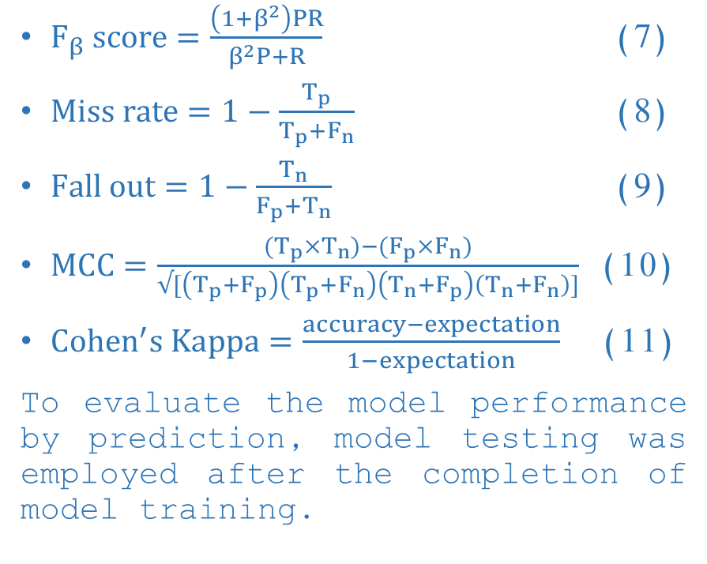
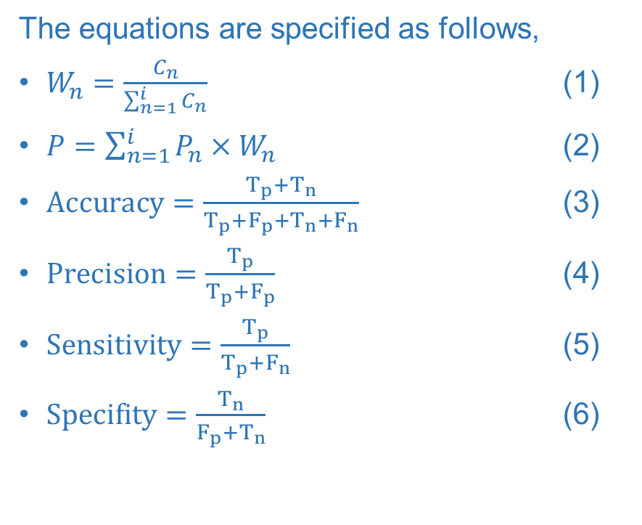
3 Proposed Methodology
The equations are specified as follows,
$W_{n}=\frac{C_{n}}{\sum_{n=1}^{i}{C_{n}}}$ (1)
$P=\sum_{n=1}^{i}{P_{n}}×W_{n}$ (2)
$Accuracy=\frac{T_{p}+T_{n}}{T_{p}+F_{p}+T_{n}+F_{n}}$ (3)
$Precision=\frac{T_{p}}{T_{p}+F_{p}}$ (4)
$Sensitivity=\frac{T_{p}}{T_{p}+F_{n}}$ (5)
$Specifity=\frac{T_{n}}{F_{p}+T_{n}}$ (6)
$F_{β} score=\frac{\left(1+β^{2}\right)PR}{β^{2}P+R}$ (7)
$Miss rate=1−\frac{T_{p}}{T_{p}+F_{n}}$ (8)
$Fall out=1−\frac{T_{n}}{F_{p}+T_{n}}$ (9)
$MCC=\frac{(T_{p}×T_{n})−(F_{p}×F_{n})}{√[\left(T_{p}+F_{p}\right)\left(T_{p}+F_{n}\right)\left(T_{n}+F_{p}\right)\left(T_{n}+F_{n}\right)]}$ (10)
$Cohen^{′}s Kappa=\frac{accuracy−expectation}{1−expectation}$ (11)
To evaluate the model performance by prediction, model testing was employed after the completion of model training.

Slide 11
4 Experimental Results
Table 2. Confusion matrix of different classifiers.
Classifiers | T_{p} | T_{n} | F_{p} | F_{n}
VGG-19 | 2,051 | 2,006 | 49 | 94
ResNet-50 | 2,004 | 2,018 | 96 | 82
Ensemble | 2,015 | 2,047 | 53 | 85

Slide 12
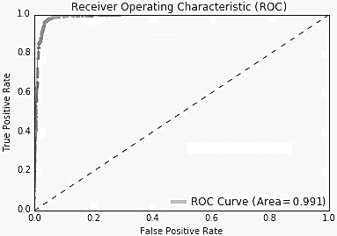
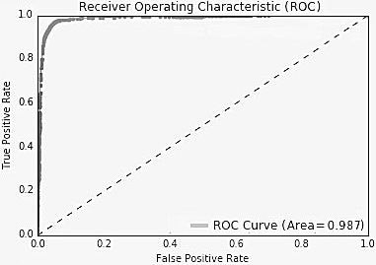
4 Experimental Results
(a)
(b)
Fig. 4. ROC graph of (a) VGG-19 and (b) ResNet-50.

Slide 13
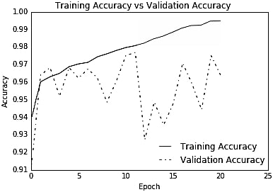
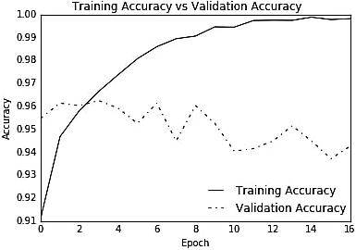
4 Experimental Results
(a)
(b)
Fig. 5. Accuracy vs. epochs graphs of (a) VGG-19 and (b) ResNet-50.

Slide 14
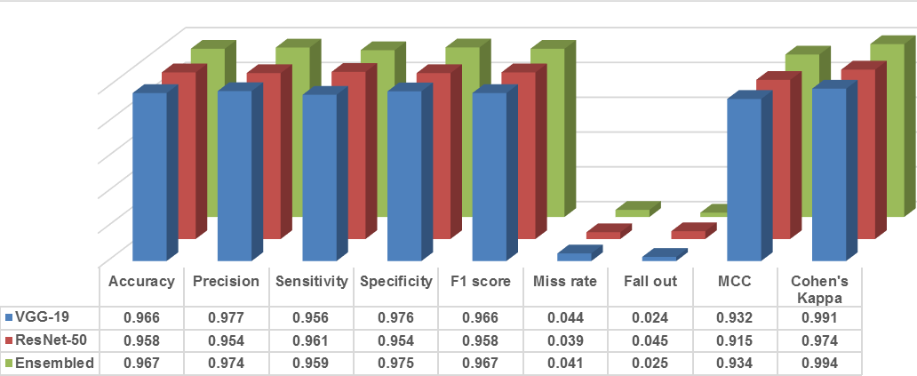
4 Experimental Results
Fig. 6. Performance metrics of malaria detection.

Slide 15
4 Experimental Results
Table 3. Performance comparison of proposed model for malaria detection.
Methods | Accuracy | Sensitivity | Specificity | F-score
Our proposed model (patient-level) | 0.967 | 0.960 | 0.975 | 0.967
Rajaraman et al. (patient-level) [3] | 0.995 | 0.971 | 0.985 | 0.995
Bibin, Nair & Punitha [4] | 0.963 | 0.976 | 0.959 | 0.897
Devi et al. [5] | 0.963 | 0.930 | 0.968 | 0.853
Das et al. [6] | 0.840 | 0.981 | 0.689 | 0.884
*The bold metrics values indicate the performance measures of the presented architecture

Slide 16
5 Conclusion
To improve the proposed model, recommendations can be made as below,
• Weight quantization on the respective models would allow a smaller version.
• The overall classiﬁcation assignment should be available over the cloud.
• An end-to-end user-friendly mobile application needs to be developed.
The proposed model provides a design for automatic malaria detecting classifier via an application programming interface (API) with not only reasonable accuracy but also well-founded computation.

Slide 17
References
[1] Malaria Datasets | National Library of Medicine, https://lhncbc.nlm.nih.gov/publication/pub9932, last accessed 2020/06/30.
[2] Common architectures in convolutional neural networks, https://www.jeremyjordan.me/convnet-architectures, last accessed 2020/06/30.
[3] Rajaraman, S., Jaeger, S., Antani, S.K.: Performance evaluation of deep neural ensembles toward malaria parasite detection in thin-blood smear images. PeerJ. 7, e6977 (2019). https://doi.org/10.7717/peerj.6977.
[4] Bibin, D., Nair, M.S., Punitha, P.: Malaria Parasite Detection from Peripheral Blood Smear Images Using Deep Belief Networks. IEEE Access. 5, 9099–9108 (2017). https://doi.org/10.1109/ACCESS.2017.2705642.
[5] Devi, S.S., Roy, A., Singha, J., Sheikh, S.A., Laskar, R.H.: Malaria infected erythrocyte classification based on a hybrid classifier using microscopic images of thin blood smear. Multimed. Tools Appl. 77, 631–660 (2018). https://doi.org/10.1007/s11042-016-4264-7.
[6] Das, D.K., Ghosh, M., Pal, M., Maiti, A.K., Chakraborty, C.: Machine learning approach for automated screening of malaria parasite using light microscopic images. Micron. 45, 97–106 (2013). https://doi.org/10.1016/j.micron.2012.11.002.

Slide 18
Thank You
Any Questions?

